Slide 1
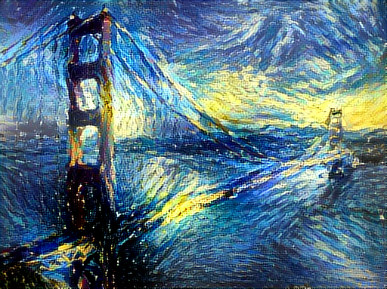
Current Events in ML for Networking Challenges, Opportunities and Realities
https://github.com/jcjohnson/neural-style
David Meyer
dmm@{uoregon.edu,1-4-5.net,…}
Huawei Future Network Theory Lab
05.15.2017

Slide 2
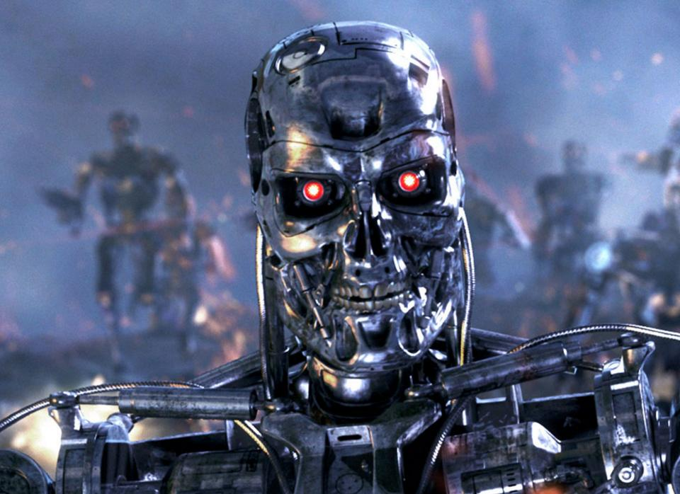
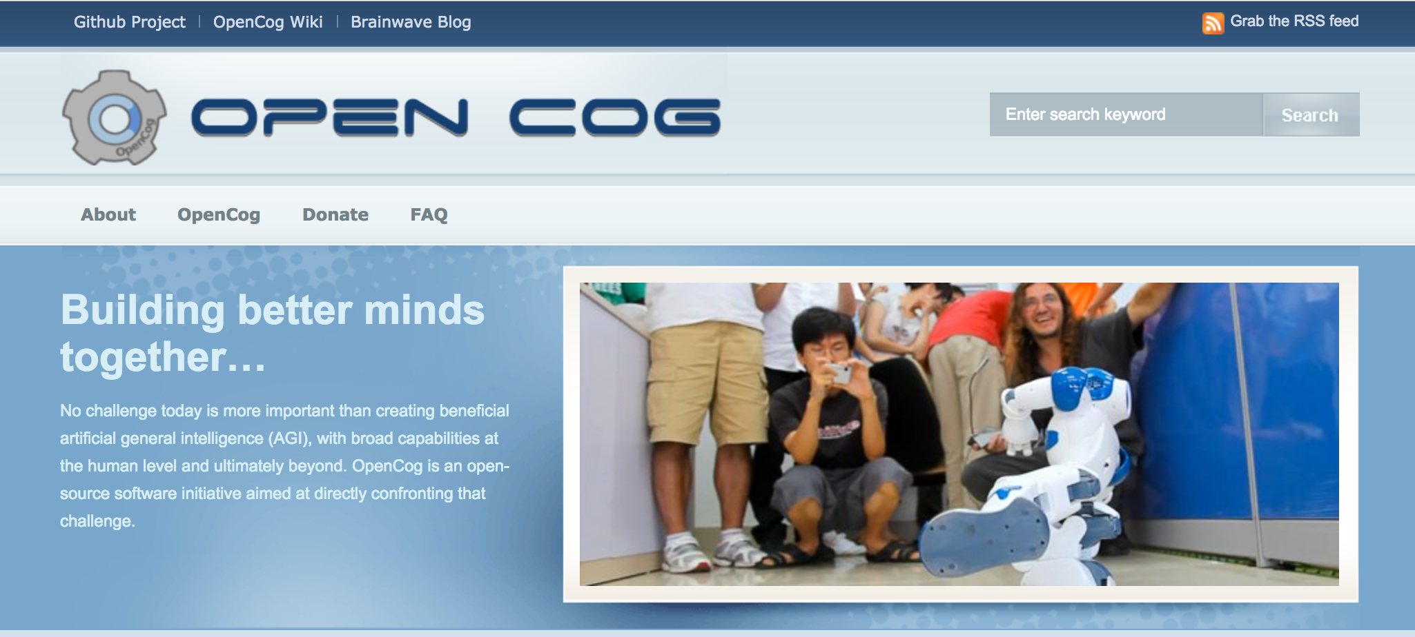
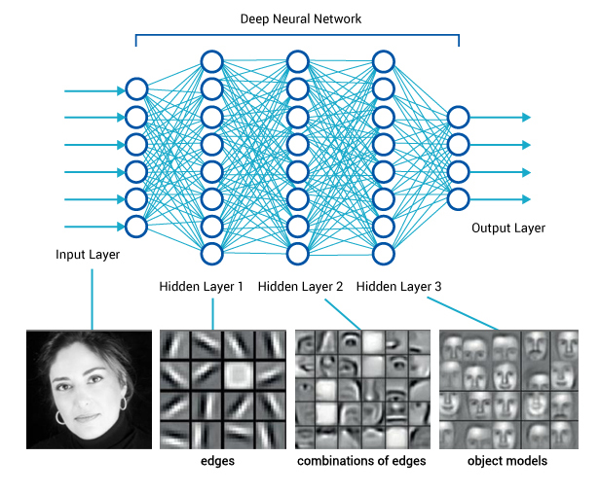
Before We Dive In
What This Talk Is Not About
Artificial General Intelligence (AGI)
Defn: An AGI is an intelligent machine
that can successfully perform any
intellectual task that a human being
can
Sometimes: Strong AI
What This Talk Is About
Machine Learning [Focus on Networking]
Solving Engineering Problems
May be used by AGI
Sometimes: Narrow or Weak AI

Slide 3
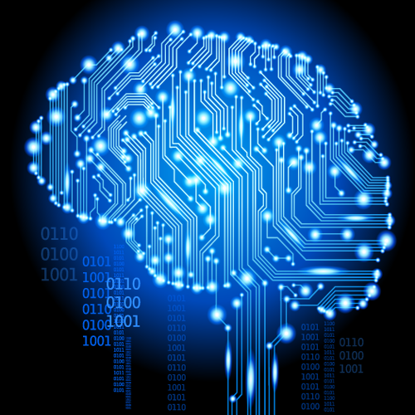
Goals For This Talk
The goals for this talk are to briefly review the
state of the art in Machine Learning as applied to data networking, with particular focus on
What is practical today
What are the challenges¹, and
What are the opportunities
We’ll go easy on the math here, but if you’re interested in that part of all of this
see http://www.1-4-5.net/~dmm/ml for some introductory material.
1 Noting the these challenges are both technological and socio-economic.

Slide 4
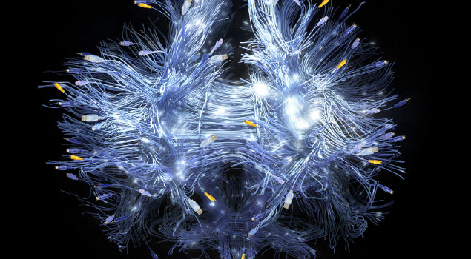
You might be surprised but what is going to drive innovation in the enterprise and in the public cloud is machine learning.
Bill Coughran, Sequoia Capital #‎ONUGSpring16‬

Slide 5
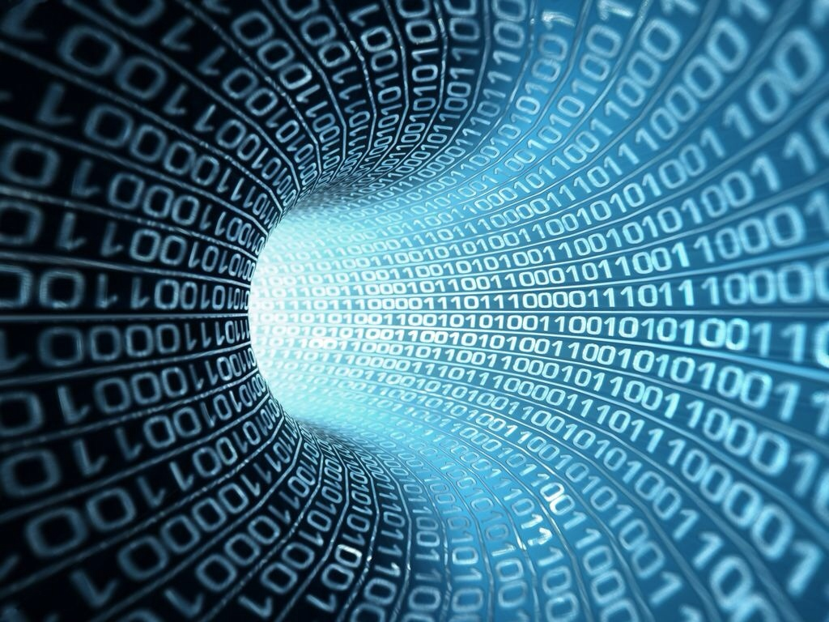
Machine Learning is the way we are going to automate your automation.
Chris Wright, RedHat CTO #RHSummit

Slide 6
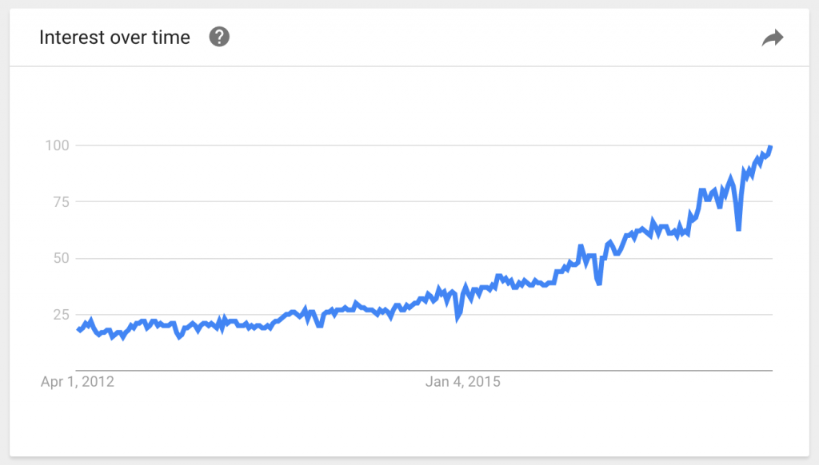
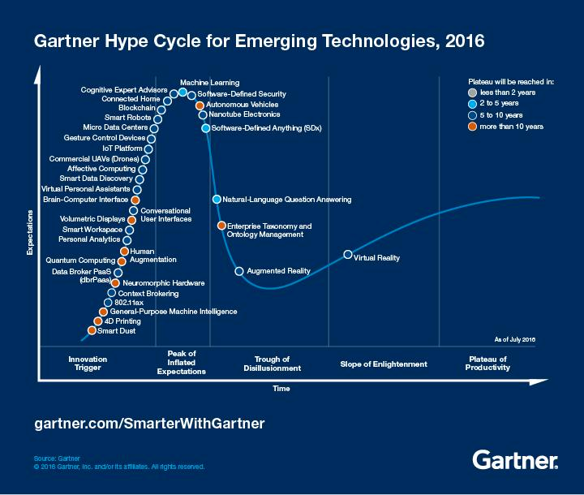
But Be Careful…
You are here (again)
Google Trends: people are searching for machine learning nearly five times as often as five years ago
http://approximatelycorrect.com/2017/03/28/the-ai-misinformation-epidemic
https://en.wikipedia.org/wiki/AI_winter

Slide 7
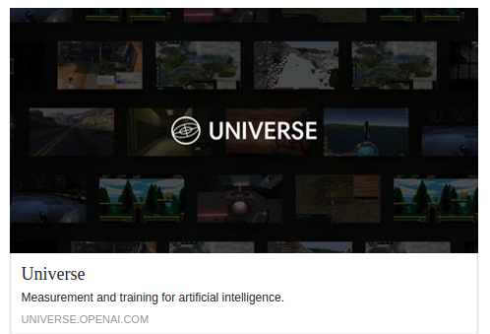
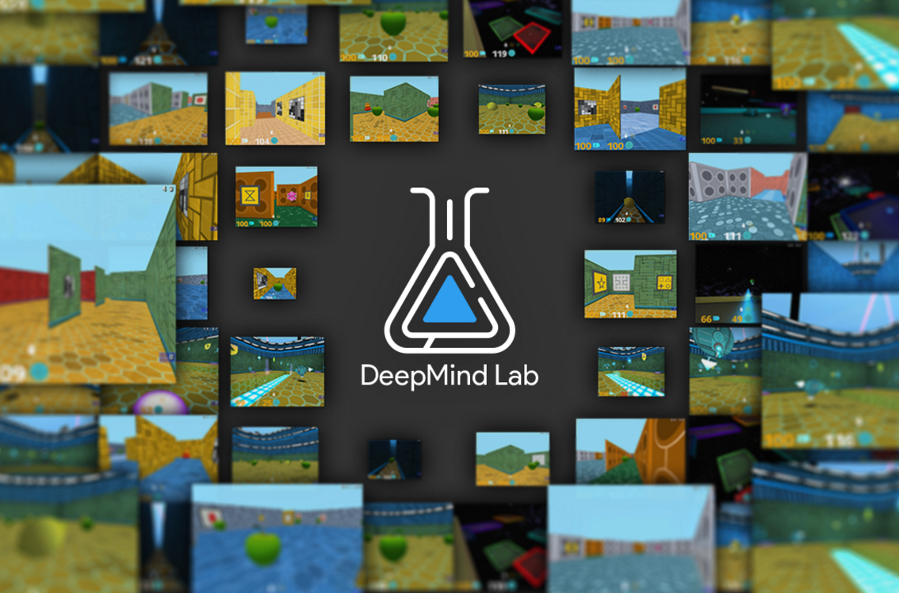
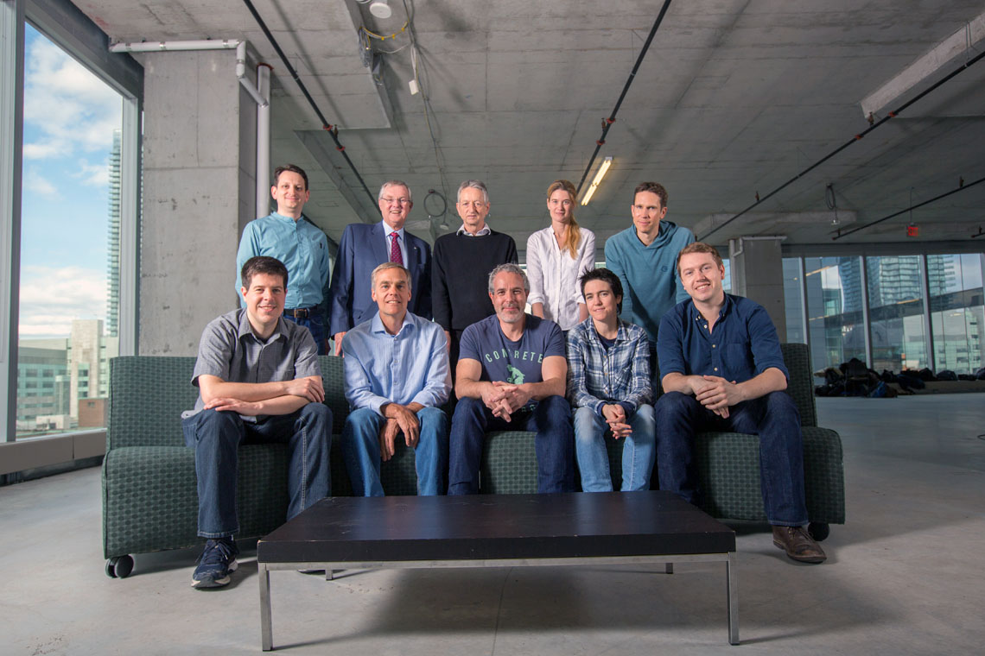
One Other Important Observation
The ML community has a long history of
Open Source
https://www.tensorflow.org, https://openai.com, …
https://deepmind.com/blog/open-sourcing-deepmind-lab
https://github.com/google/seq2seq
Open Data
http://image-net.org, …
Open Models
https://github.com/BVLC/caffe/tree/master/models/bvlc_alexnet, …
Open Science
https://arxiv.org, https://openreview.net,
Integrating all of these ideas
http://ai-on.org
http://distill.pub
So when there are important breakthroughs in ML, you see
Published descriptions and results, at least on arXiv
Diverse set of open source implementations
Growing communities
https://github.com/robertsdionne/neural-network-papers
https://github.com/kjw0612/awesome-deep-vision
Public/Private Partnerships
https://www.utoronto.ca/news/vector-institute-points-toronto-global-hot-spot-ai-research
Importantly, if you don’t see these…

Slide 8
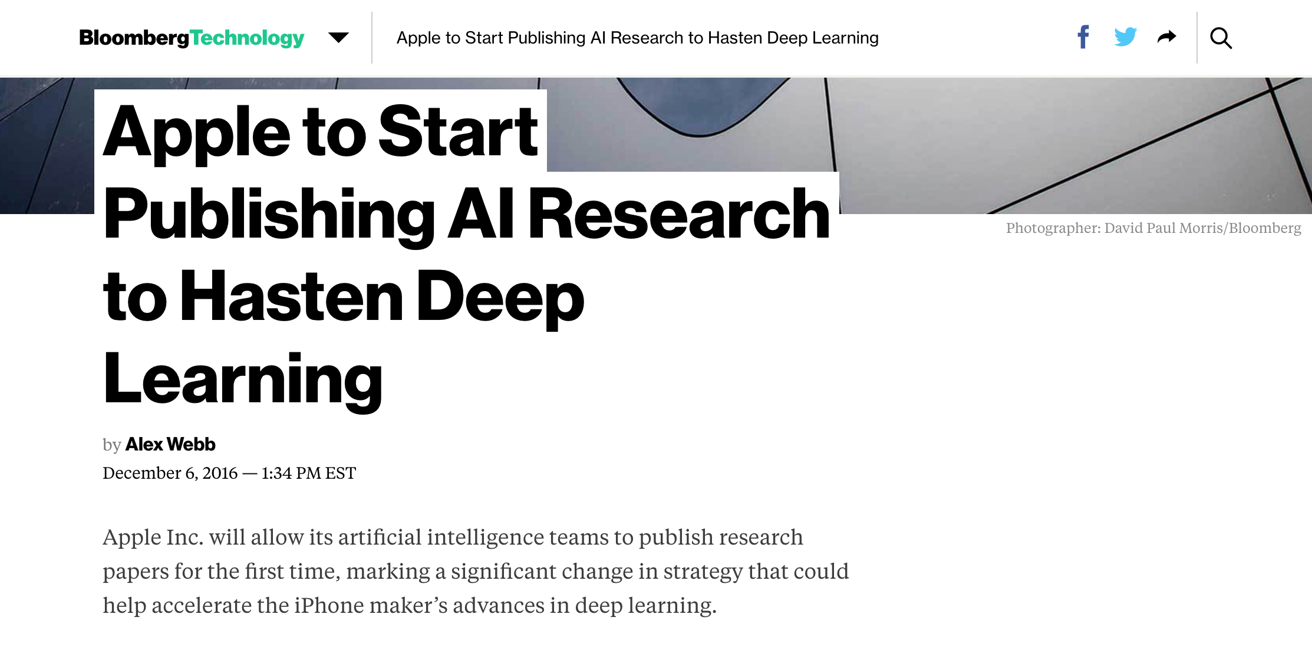
Example: Apple
https://www.bloomberg.com/news/articles/2016-12-06/apple-to-start-publishing-ai-research-to-hasten-deep-learning

Slide 9
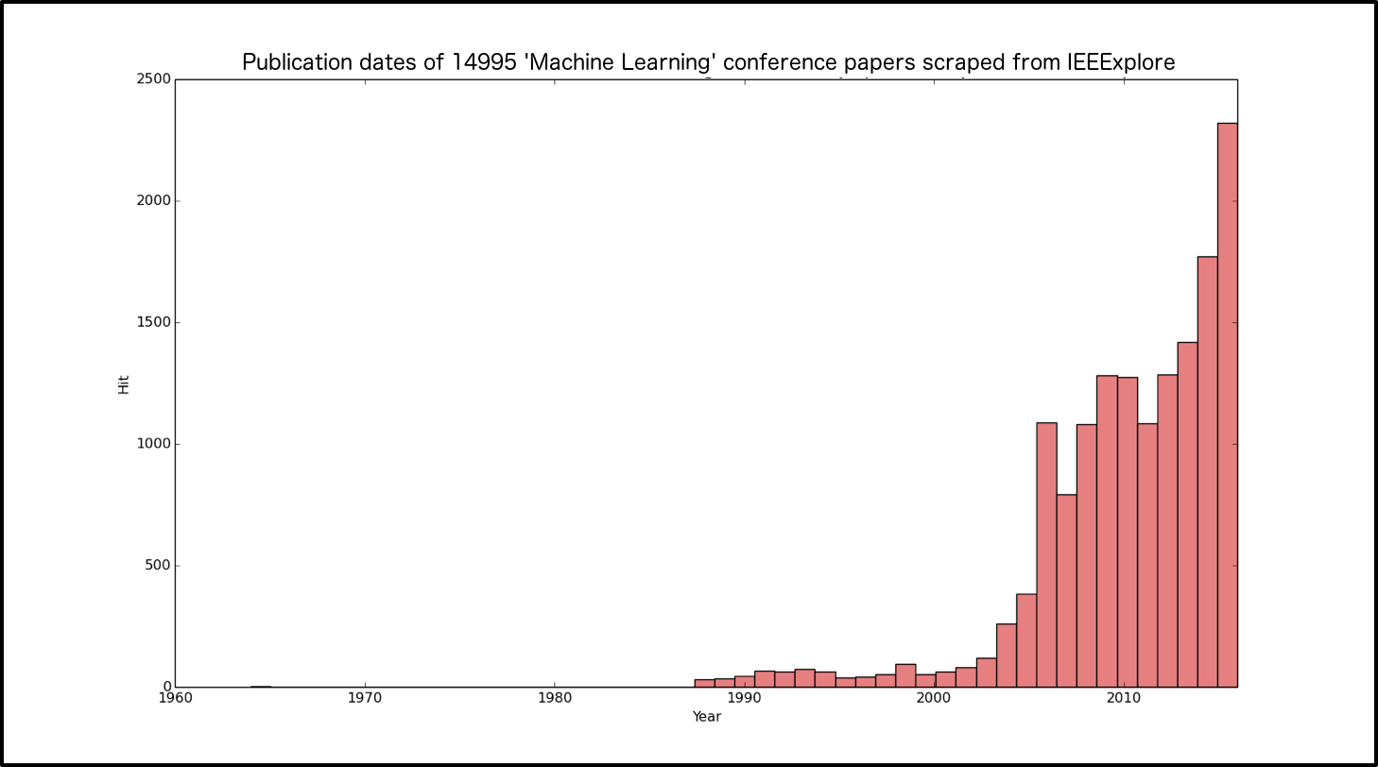
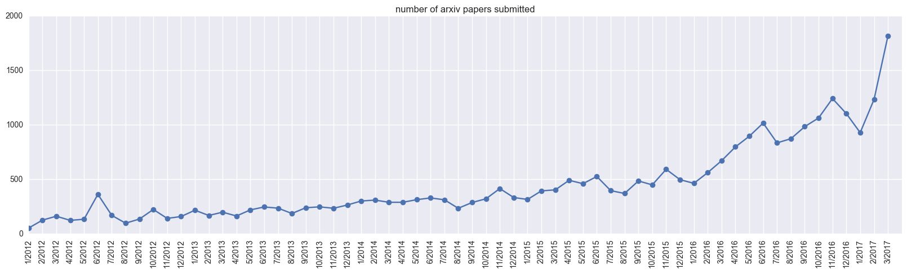
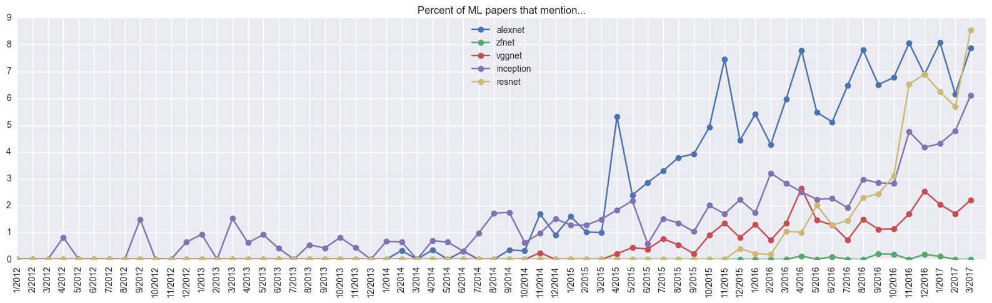
All Of That Said… All Things ML Are Moving At Warp Speed
https://medium.com/@karpathy/a-peek-at-trends-in-machine-learning-ab8a1085a106

Slide 10
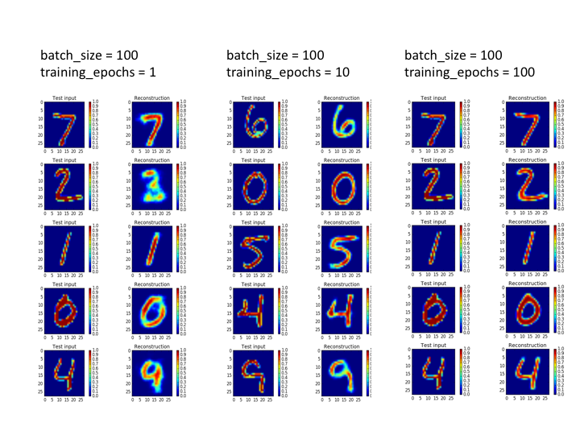
Agenda
Introduction
What Can We Do Today, And What Are The Challenges?
A Brief Look At The State Of “ML for Networking” Industry
Technical explanations/code
https://github.com/davidmeyer/ml
http://www.1-4-5.net/~dmm/ml

Slide 11
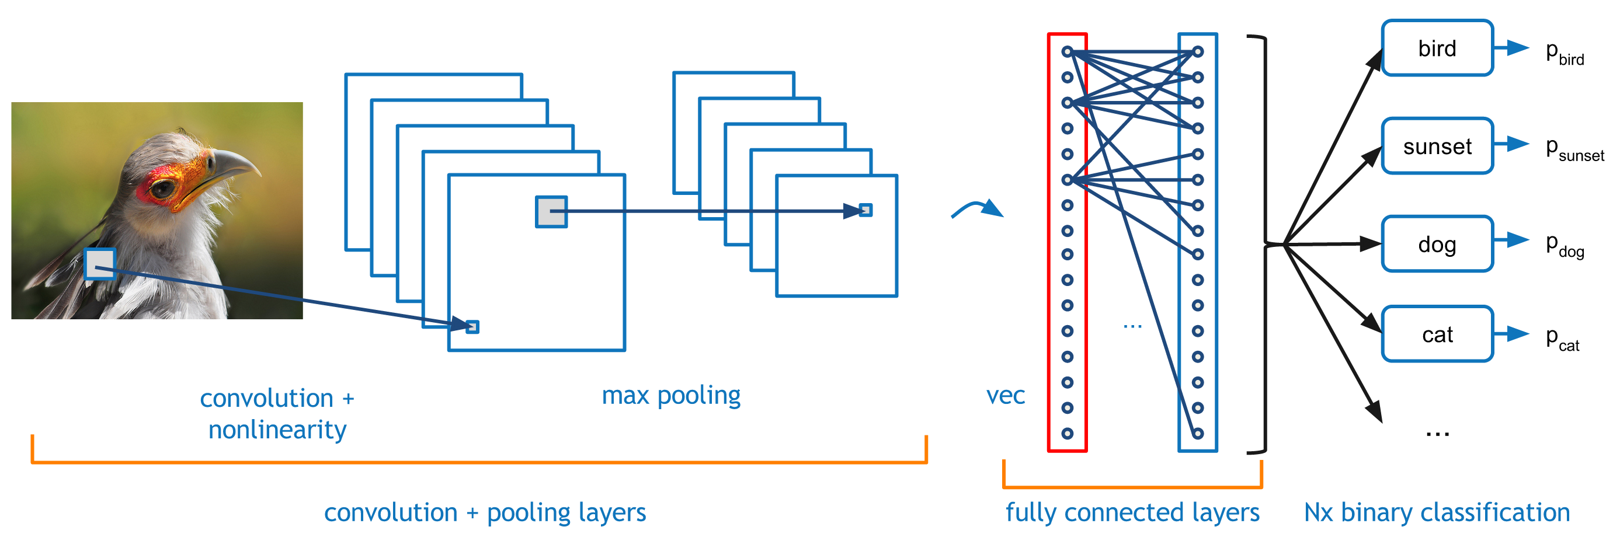
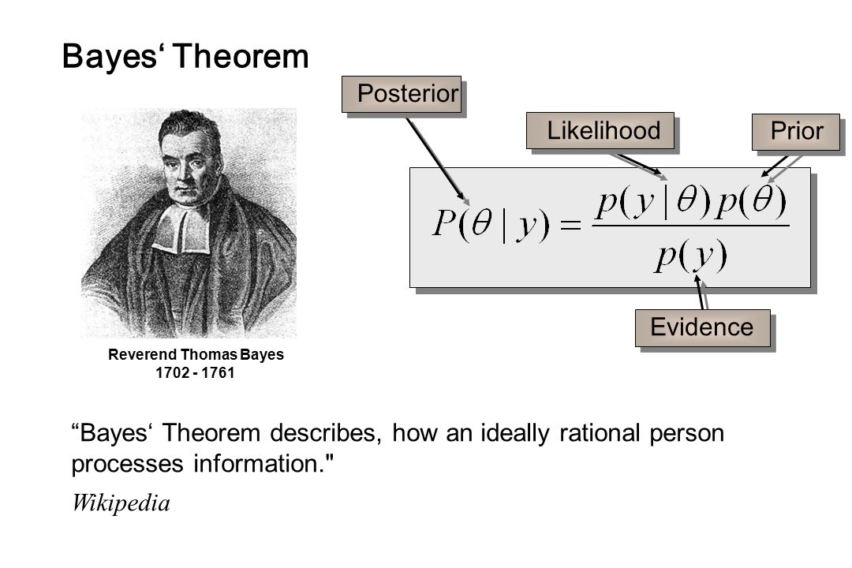
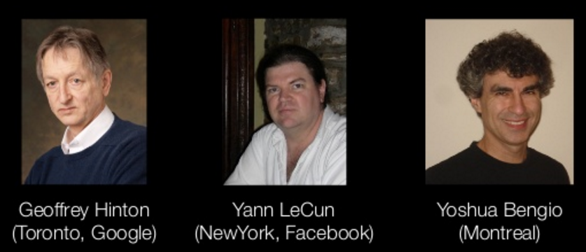
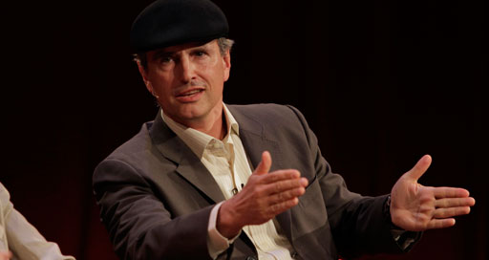
First, Where Have All The Successes Been?
Perceptual Tasks
Vision
NLP
Robotics
New Domains (medicine, finance,…)
Conv Nets
Recurrent Neural Nets
Memory Nets
Two Player Games (GANs, AEs, RL)
Network and Algorithm Design
Statistical Approaches
Some Anomaly Detection
What has driven all of this progress?
Theoretical breakthroughs in 2006
Compute
Data
Talent pipelines
We have seen relatively little progress in the network space. Why?

Slide 12
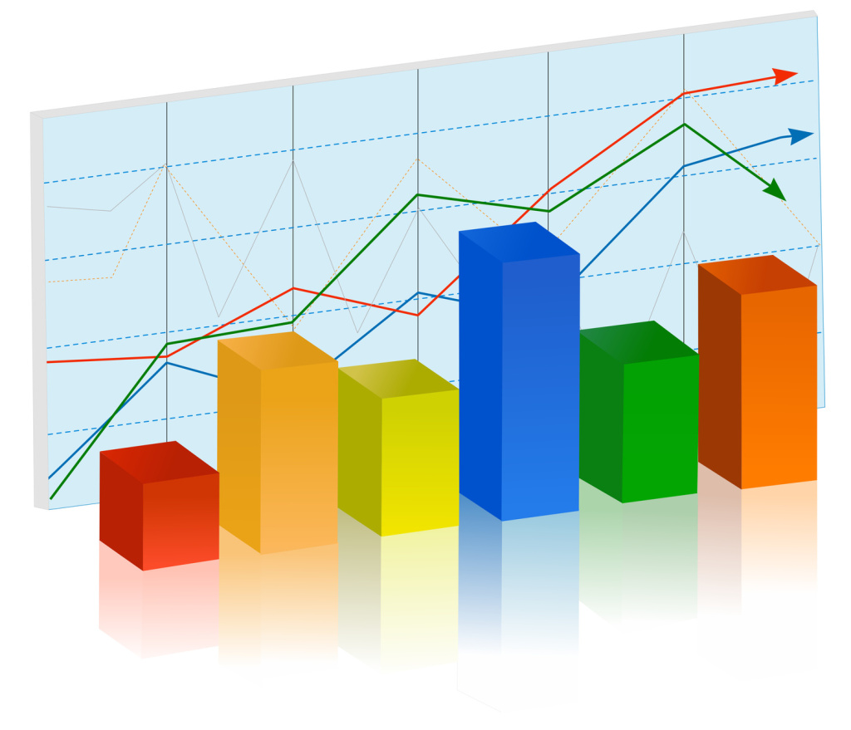
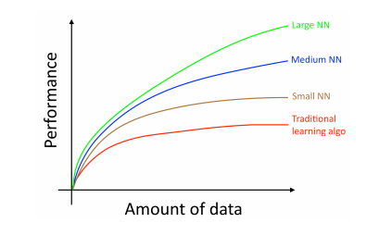
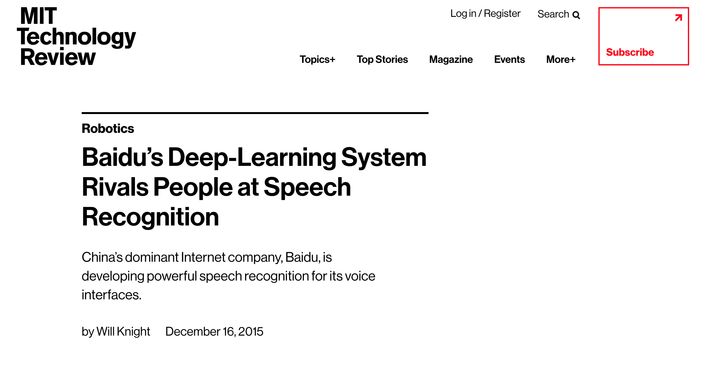
Data
Standardized data sets have been a crucial factor in the success of ML
http://yann.lecun.com/exdb/mnist/
http://image-net.org/
http://allenai.org/data.html
…
Data is the rocket fuel of Machine Learning – Andrew Ng
Allows for direct comparison of learning and inference algorithms
The result has been the steady ratcheting down of error rates on perceptual tasks to super-human levels
Object/Scene recognition
NLP/Voice recognition and generation
AlphaGo
...
We have nothing like this for networking
Many/most data sets are toy, noisy, unnormalized, …
Many data sets are proprietary
Much data non-iid (maybe time-series, maybe something else)
Most of our data sources (e.g., netflow) are representations of network data that were not built for ML
→ Effective ML systems that rely on network data will require novel approaches
There is no standard way to integrate network data with other data sources like CPU usage, memory, ...
https://docs.google.com/spreadsheets/d/1AQvZ7-Kg0lSZtG1wlgbIsrm90HaTZrJGQMz-uKRRlFw
Graph courtesy Andrew Ng

Slide 13
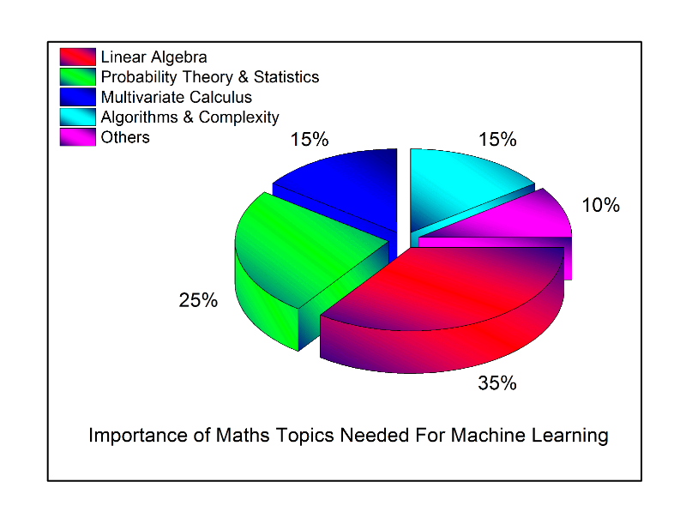
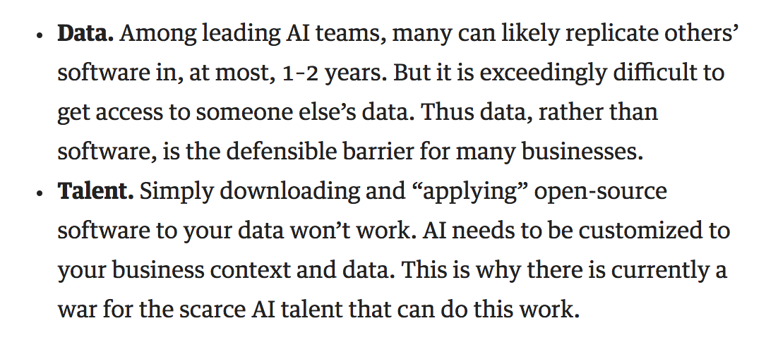
Talent Pipelines
ML is a form of Applied Mathematics
Moreover, ML is a multi-disciplinary empirical science
Network engineers typically don’t have backgrounds that include the kinds of mathematical training and experience that are essential in the ML space
Effective ML requires additional skills
Ability to rapidly learn new concepts
Data modeling and evaluation
Communications
Software engineering and system design
ML algorithms and libraries
…
The result is that there is a serious skills gap
Open source frameworks are easing this problem
However, deploying ML at scale still requires intimate understanding of the mathematics
Further, most ML {under}graduates train on perceptual tasks
https://hbr.org/2016/11/what-artificial-intelligence-can-and-cant-do-right-now
http://datascience.ibm.com/blog/the-mathematics-of-machine-learning

Slide 14
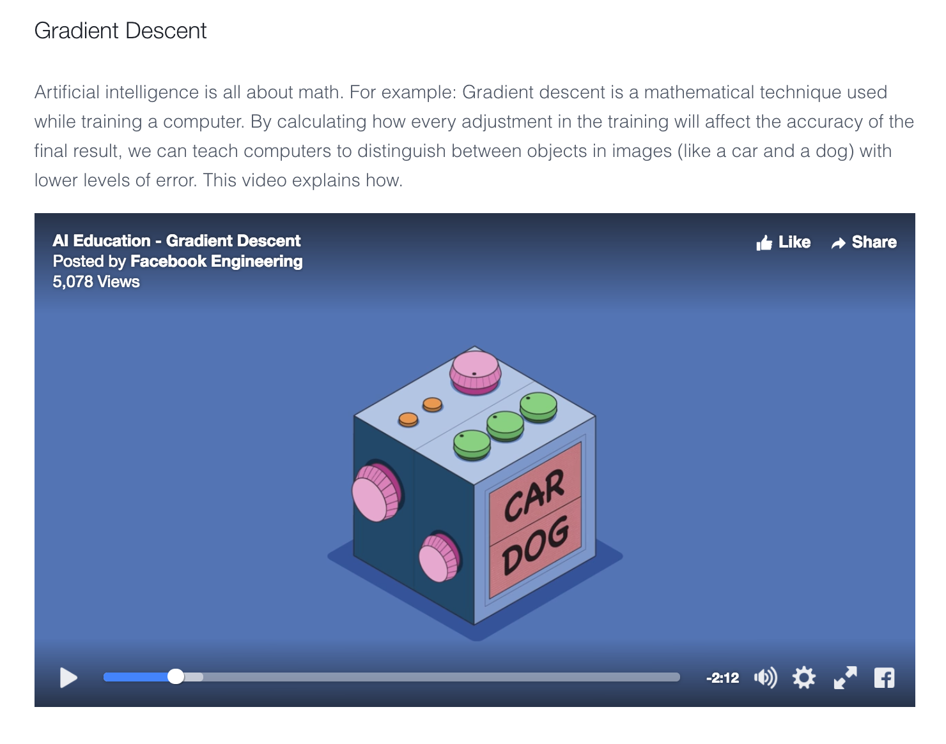
Said Another Way Artificial intelligence is all about math https://code.facebook.com/pages/1902086376686983

Slide 15
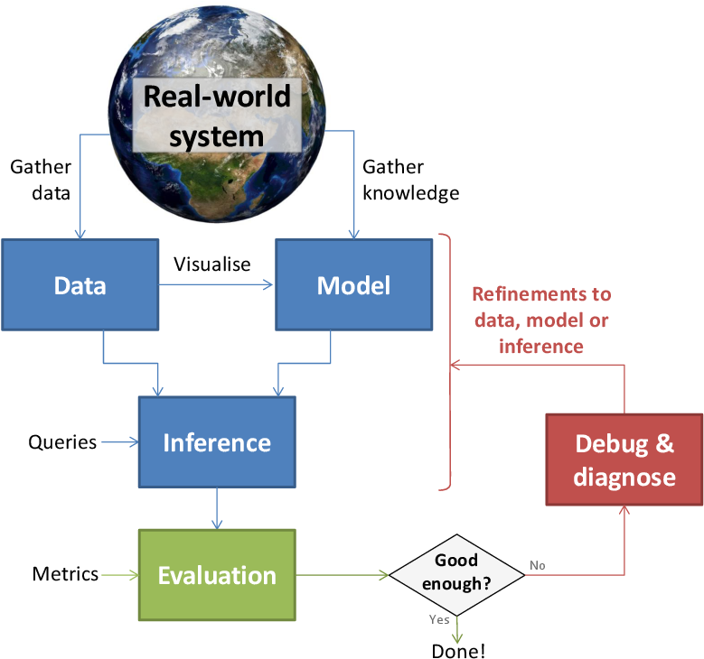
Machine Learning In The Real World
Data + Domain Knowledge
Graphic courtesy http://mbmlbook.com

Slide 16
The Scientific Method Applied To Machine Learning
This needs to be fast!
Use Case / problem definition
Scripting
HPC, GPUs, …
Hypothesis
Design ML Experiment
Execute ML Experiment
Use cases collected through Research / BU / Customer(s)
E.g. Autoencoders can detect anomalies in netflow data
Prototype environment, variable def., experimental control, significance, etc.
Execute, measure, and update hypothesis, if necessary
“If you want to increase your success rate, double your failure rate” Thomas Watson Sr. (founder of IBM)

Slide 17

Machine Learning Workflow/Pipelines For Networking
Backpropagation
Genetic Algorithm Reinforcement
Point of observation
Train model
Metering & Export
Flow collection
Ingestion
Model selection
params
packets
trunks
tables
features
Test model
Slicing
Sampling
Selecting
Netflow S-Flow Other
Bag-of-Words Statistical moments Wavelets
DNN
LSTM
SOM
Clustering
formalism
ML Framework
Handwritten code
classification
Collect packets, logs, KPIs, …
Sensors (tshark, nfdump, etc) collect and forward
Ingestion cleans, normalizes, produces feature vector
User selects model, trains, tests, and deploys model
User performs machine learning, visualization, reporting, etc.
Lots of options
80% data plumbing 20 % data science

Slide 18
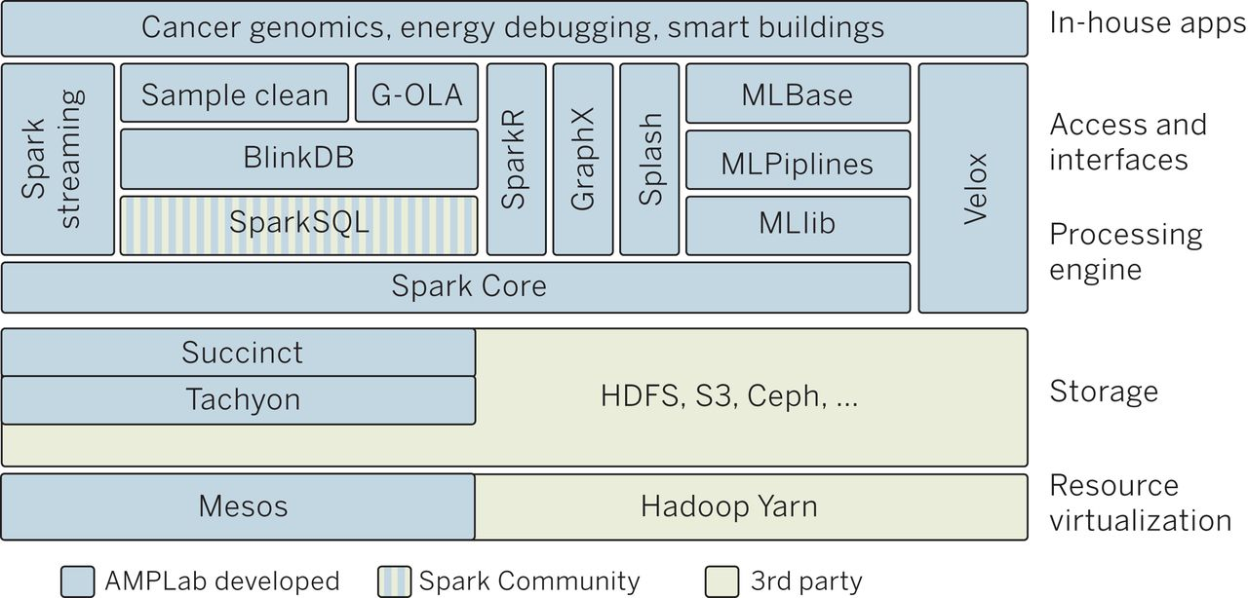
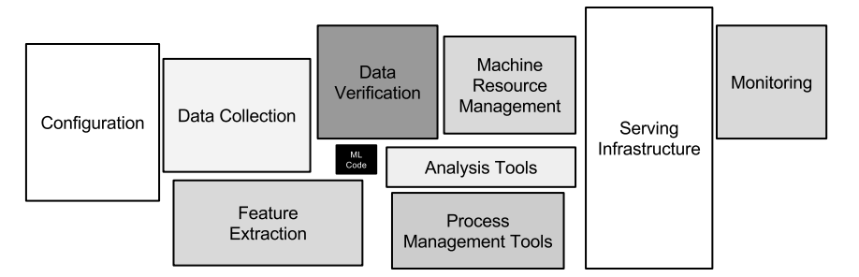
Said Another Way…
Typical ML Stack
How Much Is ML Code?
https://papers.nips.cc/paper/5656-hidden-technical-debt-in-machine-learning-systems.pdf

Slide 19
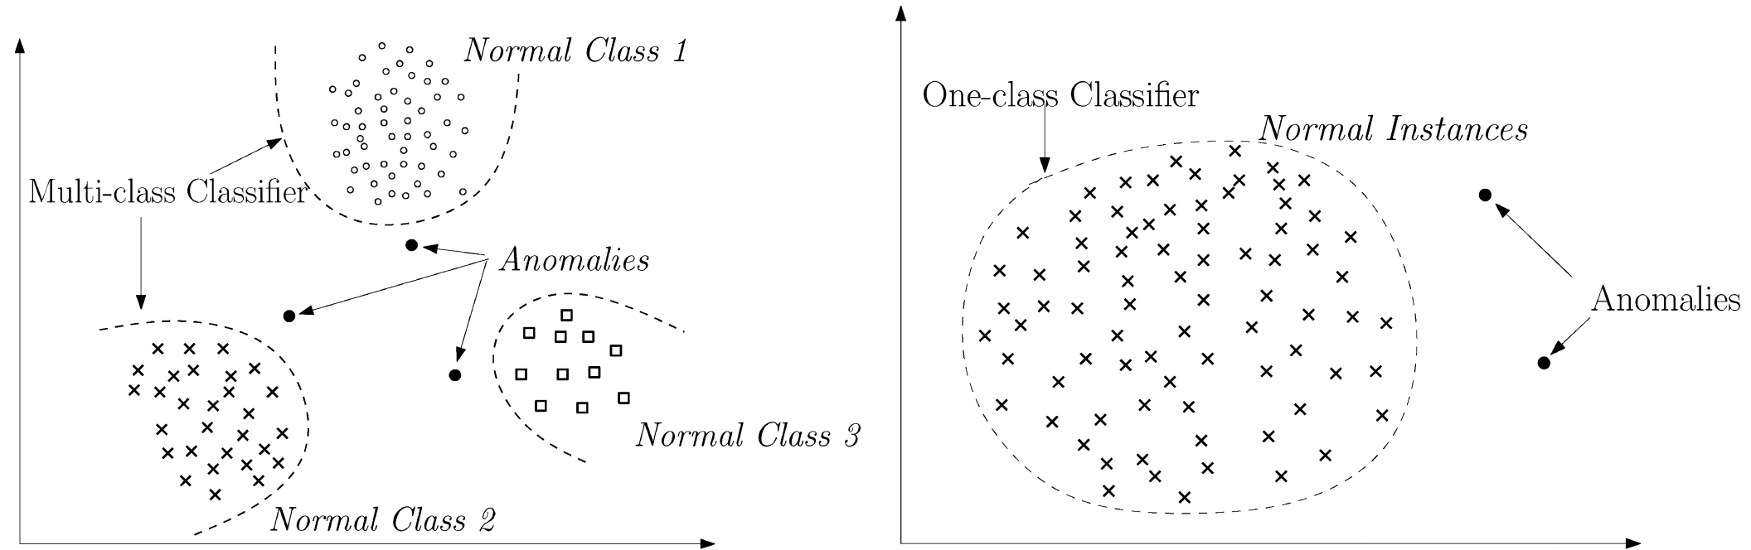
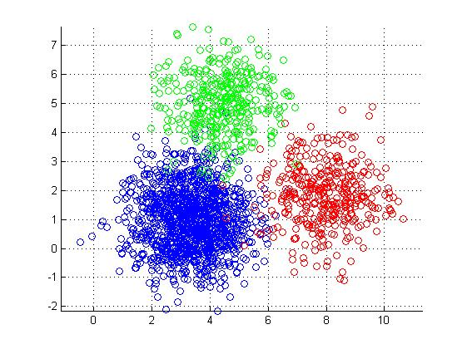
Ok, So What Is Anomaly Detection And Classification All About?
Approach
Construct nominal model (aka baseline)
Assume that data that are far from the baseline are generated by a different process (anomalies)
Evaluation of far usually requires a hyper-parameter
Linear Decision Boundary
Clustering
- K-means
- K-NN
- …
PCA
Autoencoders
….
Dimensionality
Reduction
Lots of ways to do this

Slide 20
Typical Anomaly Detection Use Case Profiling Host Behavior
Goals
Capture dominant host behavior over time
Data includes host KPIs, network traffic consumed/generated, …
Baseline generation: Assume most traffic is not anomalous
Deviations can be xfil, faults, intrusions, …
Requirements
Accurate
Minimizes false-positives/negatives
Adaptable
Stable over short time periods, adapts to long term changes
Explainable
Both inference and inferred behaviors explainable to operator/analyst
Generalizable
Finds new classes of traffic and/or anomalies
BTW, how is this possible, especially if you’ve never seen an instance?
Fast
Learning vs. Inference
Viable in high speed networks

Slide 21
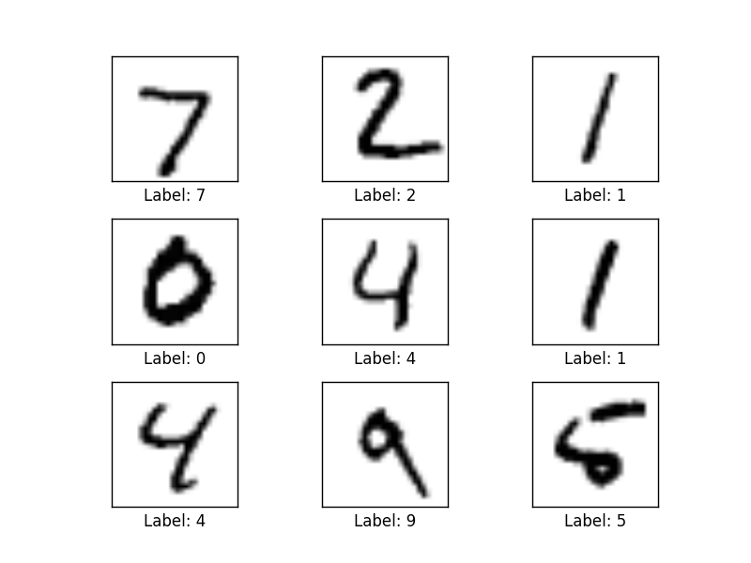
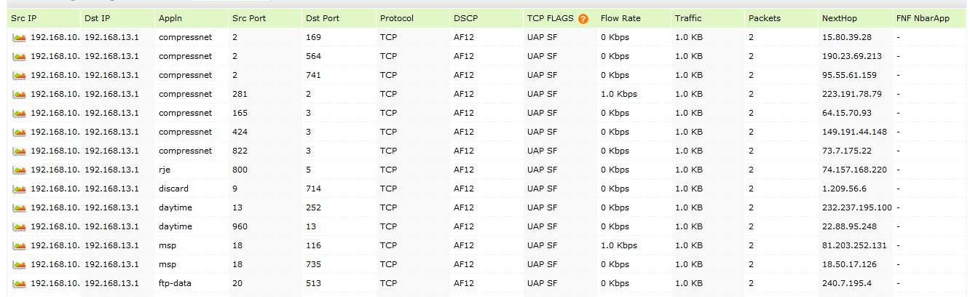
Autoencoder Example Detecting Anomalies in Handwritten Digits
MNIST: 28x28 Grayscale Handwritten Digit Dataset
Training set: 55000 images
Test set: 10000 images
Validation set: 5000 images
Features here are pixels (28x28 = 784)
BTW, MNIST typically used for supervised learning (why?)
Example here is doing unsupervised learning
I’m using MNIST here because you can easily visualize what is going on. In our case, instead of the input being vectors of {0,1} we will have vectors of counters of various features s/a bandwidth, and other network and host based metrics/KPIs.
We can analyze network/system data in the same way
Features here are
various counters
andother KPIs

Slide 22
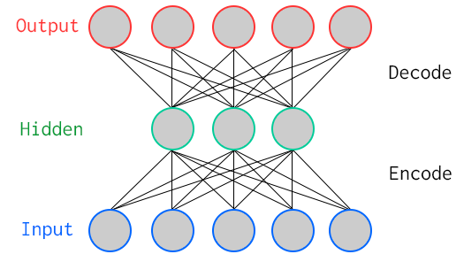
One Way To Learn To Recognize MNIST Use An Autoencoder For Binary Classification Special Kind of Neural Network
784
Artificial Neurons
100
Artificial Neurons
784
Key Characteristic: Hidden layer has fewer units than input/output → Compression
Goal: Minimize reconstruction (decode) error
How to define error (loss, cost)?
Binary classification: Threshold reconstruction error → normal/abnormal
Unsupervised learning

Slide 23
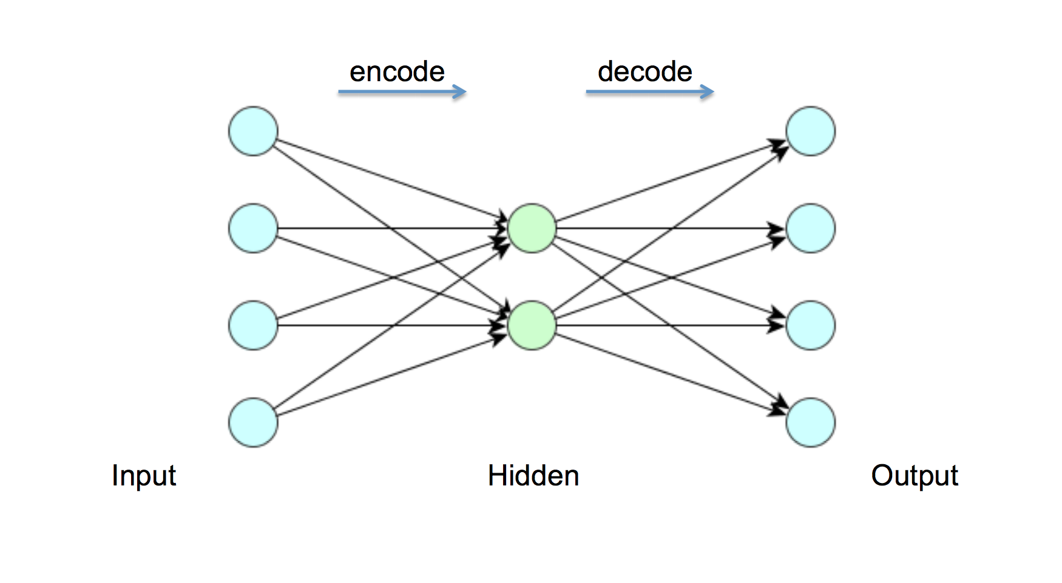
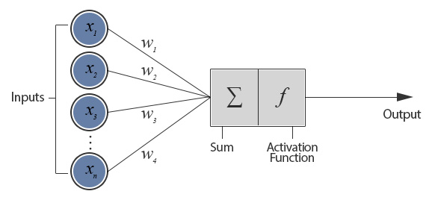
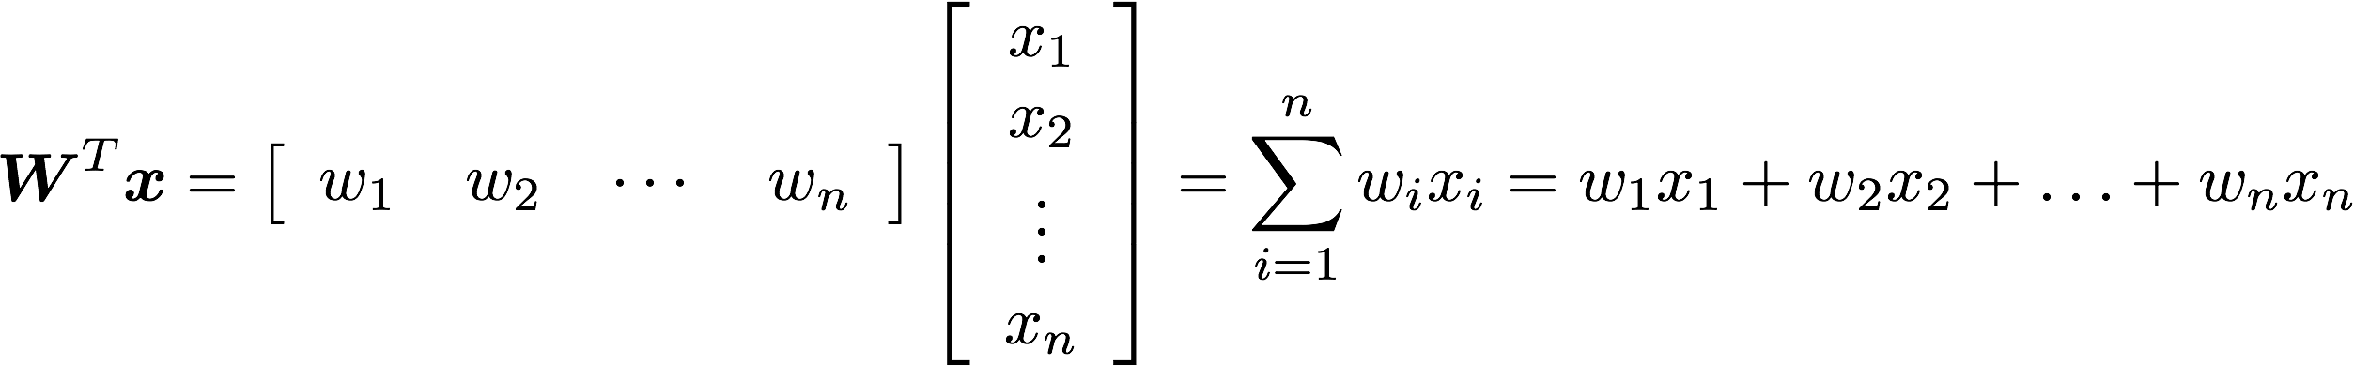
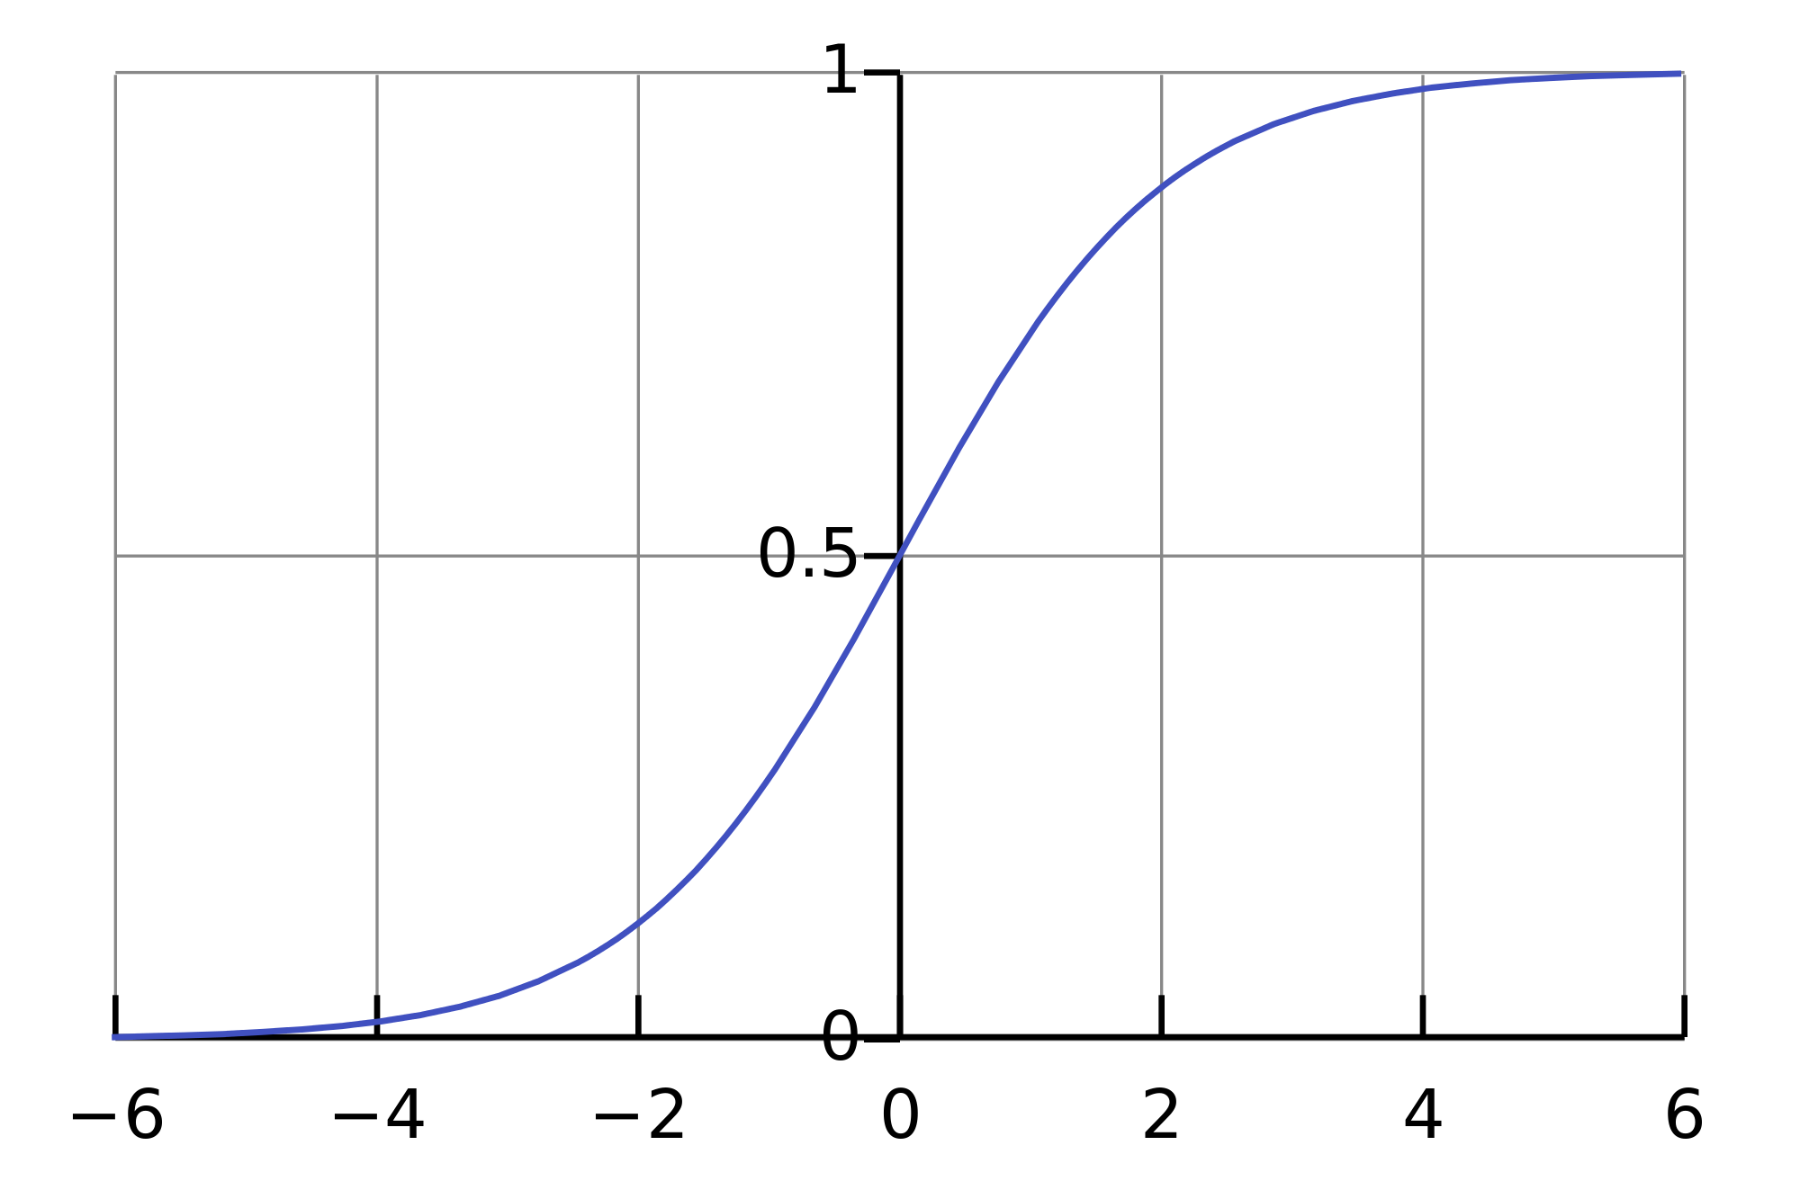
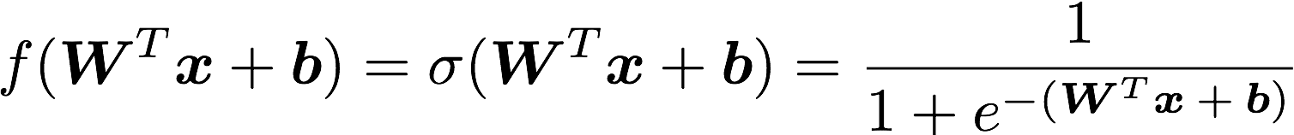
But First: What Does A Single Neuron Do?
Inner (dot) Product
784
100
784
BTW, how many parameters?
784x100 + 100x784 = 156800
Logistic or sigmoid function

Slide 24
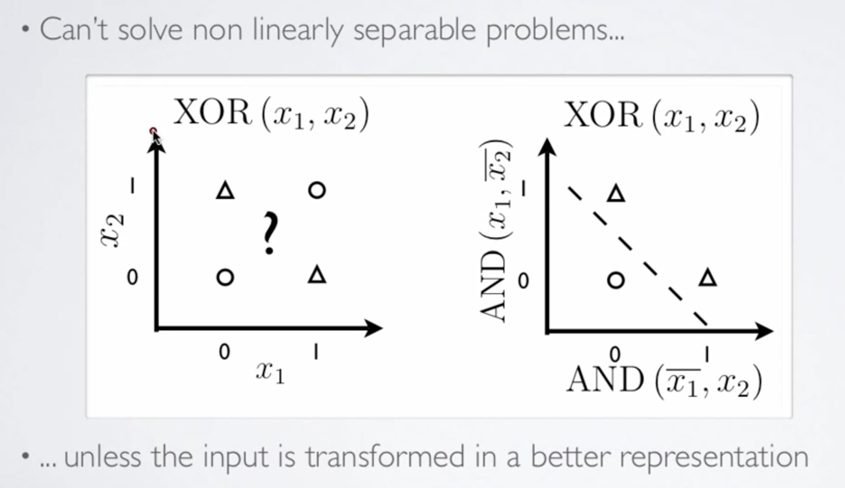
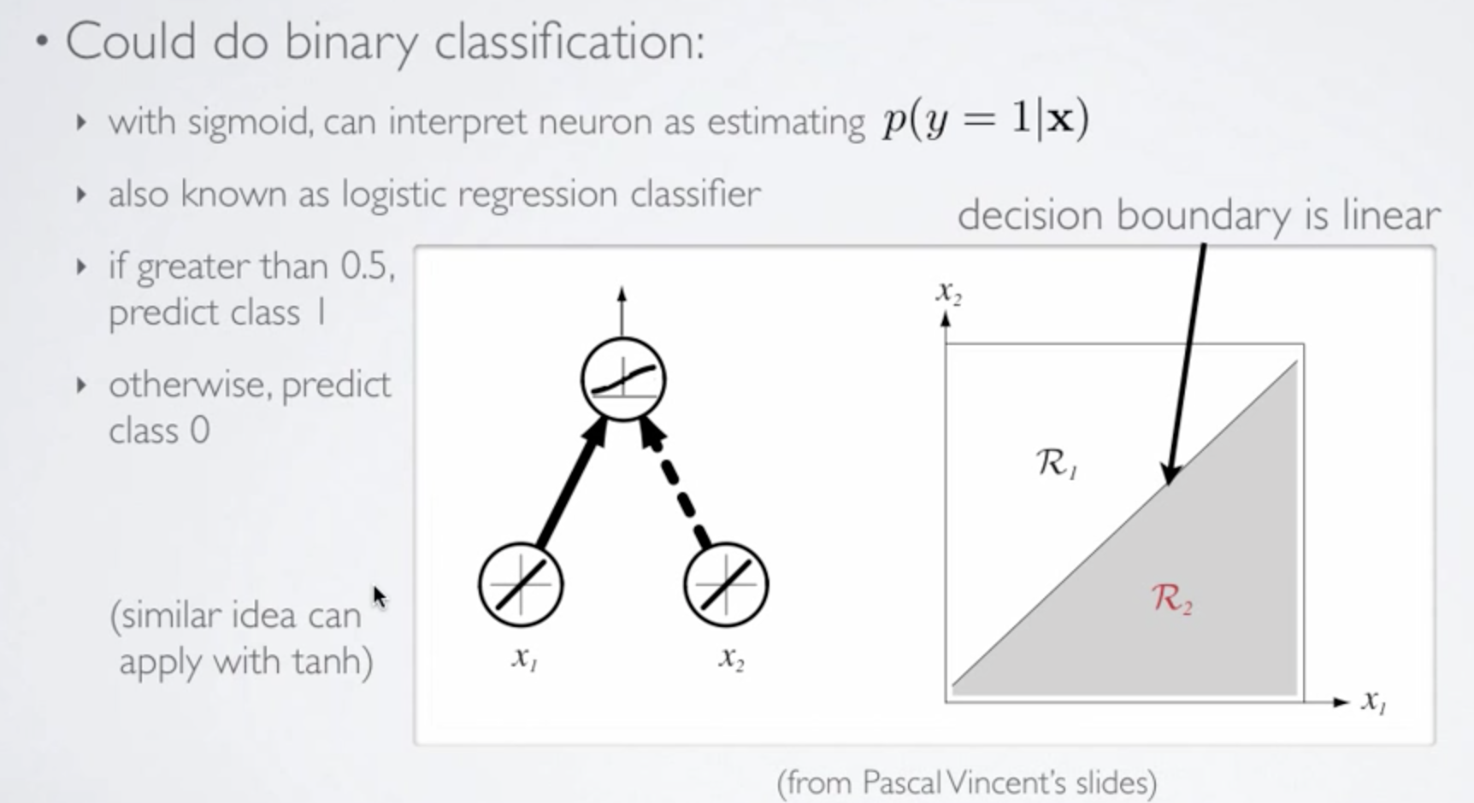
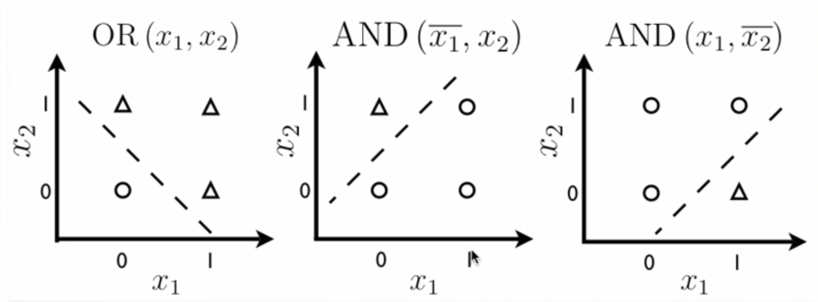
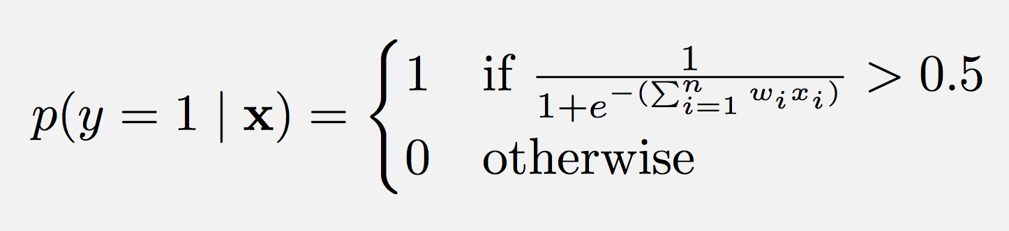
So What Kinds of Things Can a Single Artificial Neuron Compute?
Can Solve Linearly Separable Problems
Graphic courtesy Hugo Larochelle

Slide 25
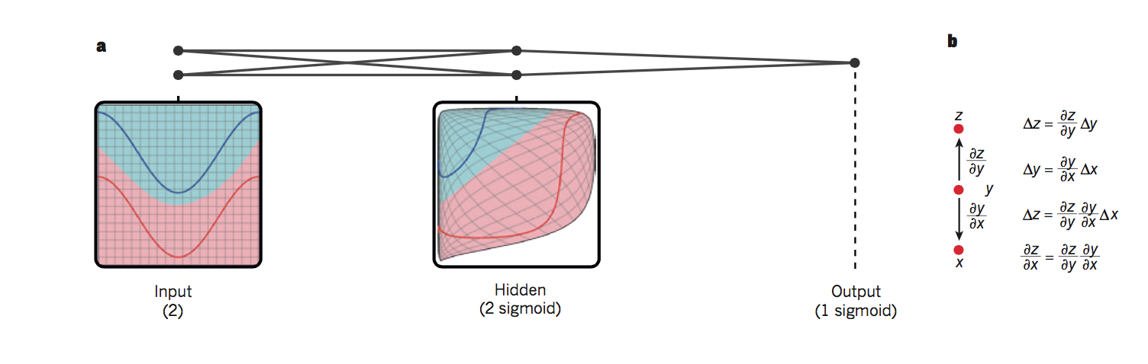
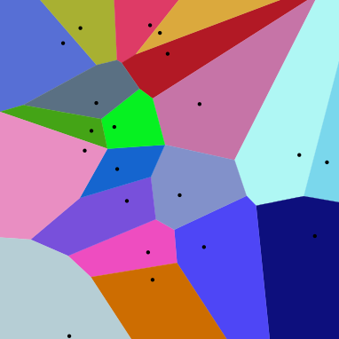
So What is Really Happening Here?
Linear Decision Boundary
Target function represented by input data is some twisted up manifold
Deep Nets disentangle the underlying explanatory factors in the data so as to make them linearly separable
Graphic courtesy Christopher Olah
Voronoi diagram under Euclidian distance
Voronoi diagram under Euclidian distance
Linear Separability in a Neural Network
Linear Separability in a Neural Network

Slide 26
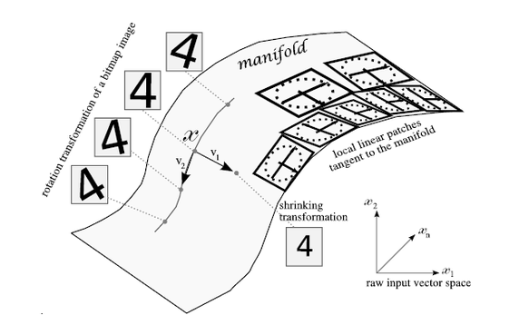
Manifolds?
X is a high dimensional vector (28² = 784)
Data concentrated around a lower dimensional manifold
Hope to find representation R of that manifold
Graphic courtesy http://www.deeplearningbook.org

Slide 27
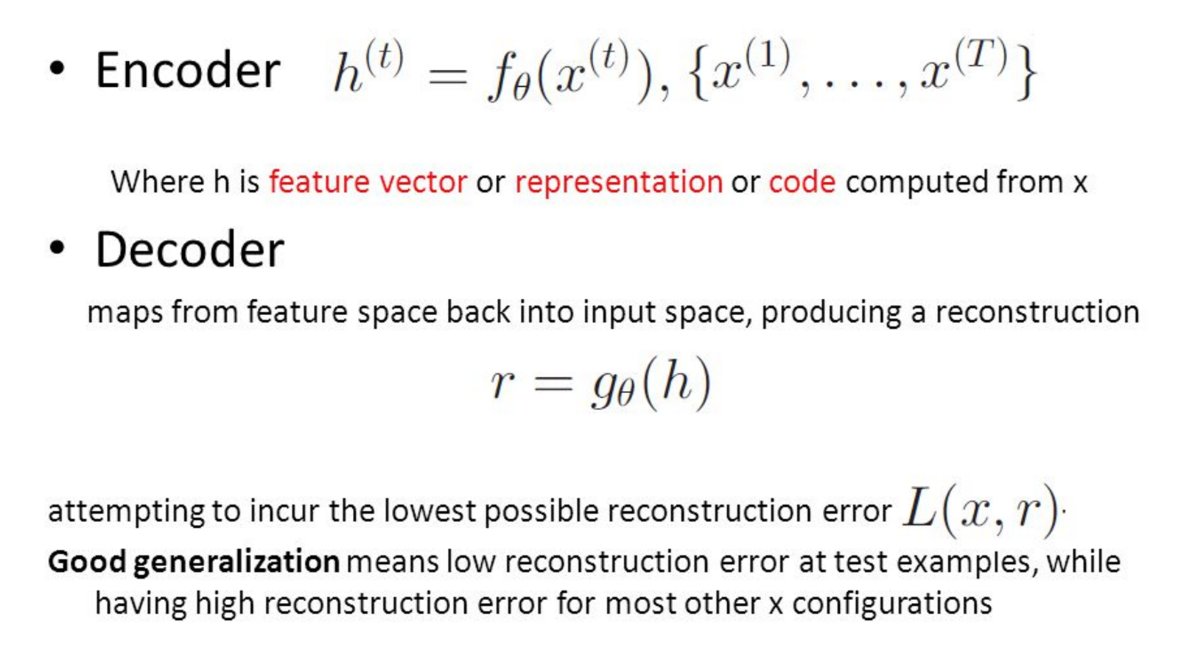
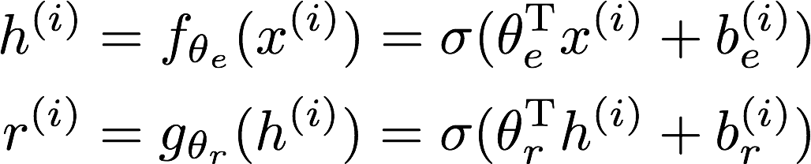
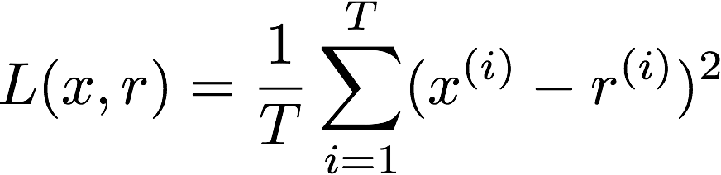
So OK, All Cool, But How Does The Autoencoder Actually Work?
Learning comes down to adjusting the weights (w_{i}’s) so that the loss L(x,r) is minimized. This is the job of the backpropagation algorithm/gradient descent (Empirical Risk Minimization).

Slide 28


How Hard To Code This Up In Tensorflow?
https://github.com/davidmeyer/ml/blob/master/tensorflow/autoencoder.{py,ipynb}

Slide 29




Autoencoder Output
1 example
10 examples
100 examples
1000 examples
After training, the AE gets low reconstruction error on digits from MNIST and high reconstruction error on everything else: It has learned to recognize MNIST

Slide 30


How Much Of This Has Been Applied To Networking?
Not too much. Many reasons:
Community challenges
Lack of understanding about how progress is made in ML, hype, skill sets, proprietary data sets/use-cases,…
Diverse types of network data
Flows, logs, various KPIs, … with no obvious/consistent way to combine
Incomplete data sets, non-iid data
Different models for different data types
Still active area of investigation
Occam’s Razor
No useful “Theory of Network”
Consider the problem of object recognition/conv nets
Receptive fields, shared weights, simple and complex cells, ...
Transfer learning
http://packetpushers.net/podcast/podcasts/pq-show-107-applicability-machine-learning-networking/

Slide 31
Agenda
Introduction
What Can We Do Today, And What Are The Challenges?
A Brief Look At The State Of “ML for Networking” Industry
Technical explanations/code
https://github.com/davidmeyer/ml
http://www.1-4-5.net/~dmm/ml

Slide 32










First, We’ve Seen All Of This (And More)
But What About Networking?

Slide 33

So What About Networking?
Machine learning is revolutionizing the world as we know it, both in and out of the
digital realms, and is predicted to expand to a $2 trillion market by 2025.

Slide 34

5G Networks

Slide 35

Perhaps More Interestingly
In this paper, we ask if machine learning can provide a viable
alternative to human-generated heuristics for resource management.
In other words: Can systems learn to manage resources on their own?
https://research.microsoft.com/en-us/UM/people/srikanth/data/deeprm_hotnets16.pdf

Slide 36

However…
Slide courtesy Armin Wasicek

Slide 37

And…

Slide 38

So Why The Slow Uptake?
Skill Sets, Data and Community Challenges Dominate
Result:
Most ML systems today use decades old technology
”Unsupervised” Learning
PCA,k-Means, k-NN, other clustering
Dimension Reduction
PGMs (e.g., LDA)
http://www.1-4-5.net/~dmm/ml/lda_intro.pdf
Various Ad-Hoc Statistical Methods
https://github.com/apache/incubator-spot
No usable “theory of network”

Slide 39
A Few Editorial Comments
Everything is ML these days (sound familiar?)
If you have breakthroughs, you’ll see
Publications, at least on arXiv
Open source implementations
Communities
Most ML systems today are largely comprised of open source “big data” components (big data platform), ad-hoc statistical (”ML”) technology, some hardware, and a healthy dose of marketing/hype
ML in this context means “data driven”
Standard in the industry these days
Watch out for Mlwashing (remember Openwashing?)

Slide 40




We Also Need To Learn From Our Environment Learn Control, Not Just Prediction
Hard coded control logic (not learned)
Security: Agent can learn dynamic/evolving behavior of adversary
DevOPs: Agent can learn workflow automation (e.g. Openstack Mistral)
Orchestration: Agent can learn dynamic behavior of VNFs/system
Deep policy net, $π\left(s\right)=a, s∈S, a∈A\left(s\right),$can capture human intuition
http://www.nature.com/nature/journal/v529/n7587/full/nature16961.html

Slide 41


Static vs. Reinforcement Learning Architectures
Today’s Static ML Architectures
ML doesn’t have “agency”
Hard-coded or open loop control
Learns prediction
Doesn’t learn control
Assumes stationary DGD
Largely off-line
Reinforcement Learning Architecture
Agent architecture
Agent learns control/action selection
Adapts to evolving environment
Non-stationary distributions
Network gamification
Evolution Strategies
https://blog.openai.com/evolution-strategies/

Slide 42

Combining SDN and Machine Learning
https://arxiv.org/abs/1606.06222

Slide 43
Knowledge-Defined Networking Basic Control Loop
Note: There is hard coded
logic in this picture
Graphic courtesy Albert Cabellos

Slide 44
Kinds of Applications We Are Doing?
Recommendation
Optimization
Hidden Information
Complex systems
Estimation
Performance/Cost
Validation
Performance/Cost
Knowledge discovery
Graphic courtesy Albert Cabellos

Slide 45


Example: Can We Learn Optimal Paths In An Overlay Network?
B
A
Unknown undelay
network
D
C
Which egress/ingress links should overlay routers use? E.g. A or B and C or D?
Underlay is assumed that has an arbitrary constant routing
Underlay is assumed as hidden and not under our control
Overlay protocol is assumed to be able to choose egress and ingress links, we refer to this as routing policy
Goal: Achieve overall minimum latency between overlay nodes

Slide 46


Optimizing Paths, cont
What we want to predict
For a given traffic matrix, predict the ingress/egress link configuration that minimizes delay between ingress and egress
Training Set
{(x^{(i)},y^{(i)})}, i = 1,…,N
x^{(i)} = (src^{(i)}, dst^{(i)}, bandwitdth^{(i)})
y^{(i)} = delay^{(i)}
Loss function: sum of delays (minimize this)
Learn f: X → Y
y^{(i)} = f(x^{(i)})
For a new x predict y
Models
Neural Network
SVM
Polynomial Regession
SDN Controller
Model
Optimize
Train
http://knowledgedefinednetworking.org/

Slide 47
Summary
Lots of Network Data
Standardized and labeled datasets still scarce
However, most network data sources (e.g., netflow) not designed for ML
Arbitrary data might be over-valued
Lots of open source ML frameworks, Cloud APIs, Examples, …
Google -- Tensorflow (tensorflow.org)
Facebook -- Torch (torch.ch)
Microsoft -- CNTK (https://github.com/Microsoft/CNTK)
Amazon -- MXNET (https://aws.amazon.com/mxnet)
DeepMind – Sonnet (https://github.com/deepmind/sonnet)
Other popular frameworks
Keras (https://keras.io/)
Theano (https://github.com/Theano)
…
However, networking industry still dominated by MLwashing, platforms, clustering, …
Skills gap persists and it still requires skill/experience to
Build DNN architectures/models
Find ”good” settings for hyper-parameters
Prevent overfitting
But again, be careful: SOTA LSTMs+RLs are starting to be able to build neural networks
https://openreview.net/pdf?id=r1Ue8Hcxg, http://papers.nips.cc/paper/6461-learning-to-learn-by-gradient-descent-by-gradient-descent.pdf, …
…
All of this said, you will be seeing ML in all facets of networking
And everything else for that matter

Slide 48

So Call To Action Where Do We Need To Focus?
Find a Useful Theory of Networking (for ML)
As opposed to ad-hoc approaches
Again, consider the success of convolutional neural networks
What is the “interlingua” for networking?
Public Data Sets
Skill Sets
Can Machine Learning be Democratized?
http://knowledge.wharton.upenn.edu/article/democratization-ai-means-tech-innovation
Apply, and Deploy SOTA ML Algorithms
Requires scalable ML platforms, frameworks, and associated automation
Explainable end-to-end systems
Learn control not just prediction → Learn from experience
Reinforcement Learning
Evolution Strategies (https://blog.openai.com/evolution-strategies)
Overcome Catastrophic Forgetting (in neural networks) (https://arxiv.org/abs/1612.00796)
…

Slide 49





Finally…Many Beautiful Mysteries Remain
Backpropagation
Gradient-based optimization/back-propagation
Why is such a simple algorithm so powerful?
Adversarial Examples
https://arxiv.org/pdf/1412.6572.pdf
Transferability (https://arxiv.org/pdf/1704.03453.pdf)
New optimizer/optimizee paradigms
AlphaGo
https://deepmind.com/research/alphago
Generative Adversarial Nets (GANs)
https://arxiv.org/abs/1412.6572
Learning to learn by gradient descent by gradient descent
https://arxiv.org/abs/1606.04474
Neural Architecture Search With Reinforcement Learning
https://openreview.net/pdf?id=r1Ue8Hcxg
Neural Nets
What are the units (artificial neurons) actually doing?
https://arxiv.org/pdf/1509.06321.pdf
Sentiment Neurons
https://blog.openai.com/unsupervised-sentiment-neuron/
Why does deep and cheap learning work so well?
Physics perspective
http://arxiv.org/pdf/1608.08225v1.pdf
Many Others
So how many 28x28 grayscale images are there?
Say there are 8 bits of grayscale → 256⁷⁸⁴ possible images
Our autoencoder had 156800 parameters and 156800/256⁷⁸⁴ $≈0$
So how can a simple autoencoder find the MNIST subspace?

Slide 50
Agenda
Introduction
What Can We Do Today, And What Are The Challenges?
A Brief Look At The State Of “ML for Networking” Industry
Technical explanations/code
https://github.com/davidmeyer/ml
http://www.1-4-5.net/~dmm/ml

Slide 51
Thank you

